Slide 1
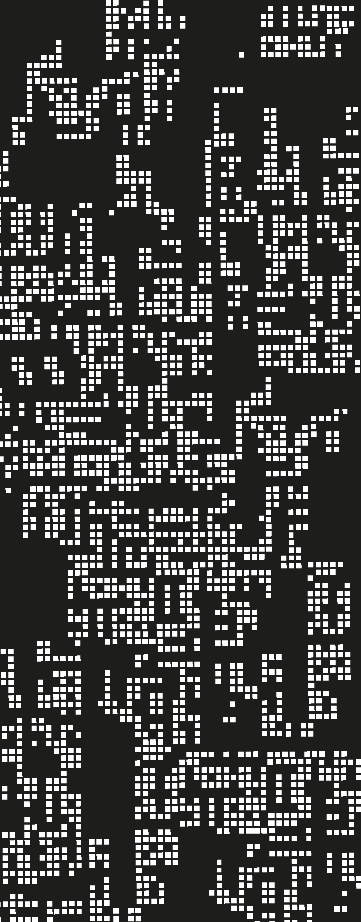
Alcohol Consumption in the UK: A Statistical Analysis
Based on Health Survey for England, 2011
Name: Mohamed Khaled Alzaabi
Course: Numerical Analysis
Date: 21/04/2025

Slide 2
Introduction
01

Slide 3
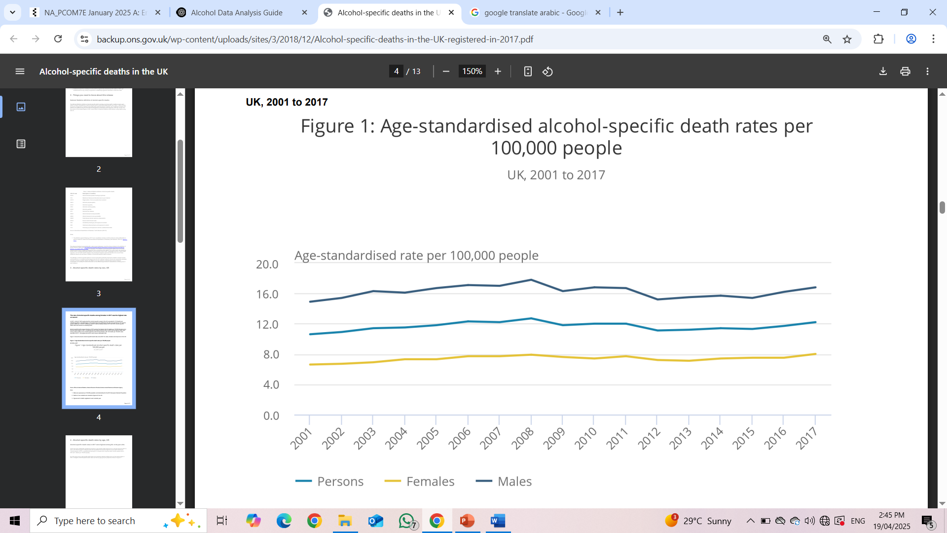
Introduction to Alcohol in the UK
Chart: Alcohol-specific death rates (source: ONS)
338,000
Alcohol-related hospital admission in 2017/18
5,843
Alcohol –specific deaths in same year (ONS, 2019)
6%
Increase in deaths since 2016

Slide 4
Purpose, Dataset, Methodology
Dataset
Purpose
N
Tools
Analysis
Health Survey for England 2011
Explore factors related to alcohol consumption
8,610 adults
R Studio
Descriptive statistics, t-test, chi-square tests, ANOVA, correlations

Slide 5
Why Use R for This Analysis?
Open-source and widely used in research
Reproducible scripts
Advanced visualization tools
Powerful statistical libraries (dplyr, ggplot2, etc.)
Flexibility
Reproducibility
Visualization

Slide 6
Descriptive Statistics
02

Slide 7
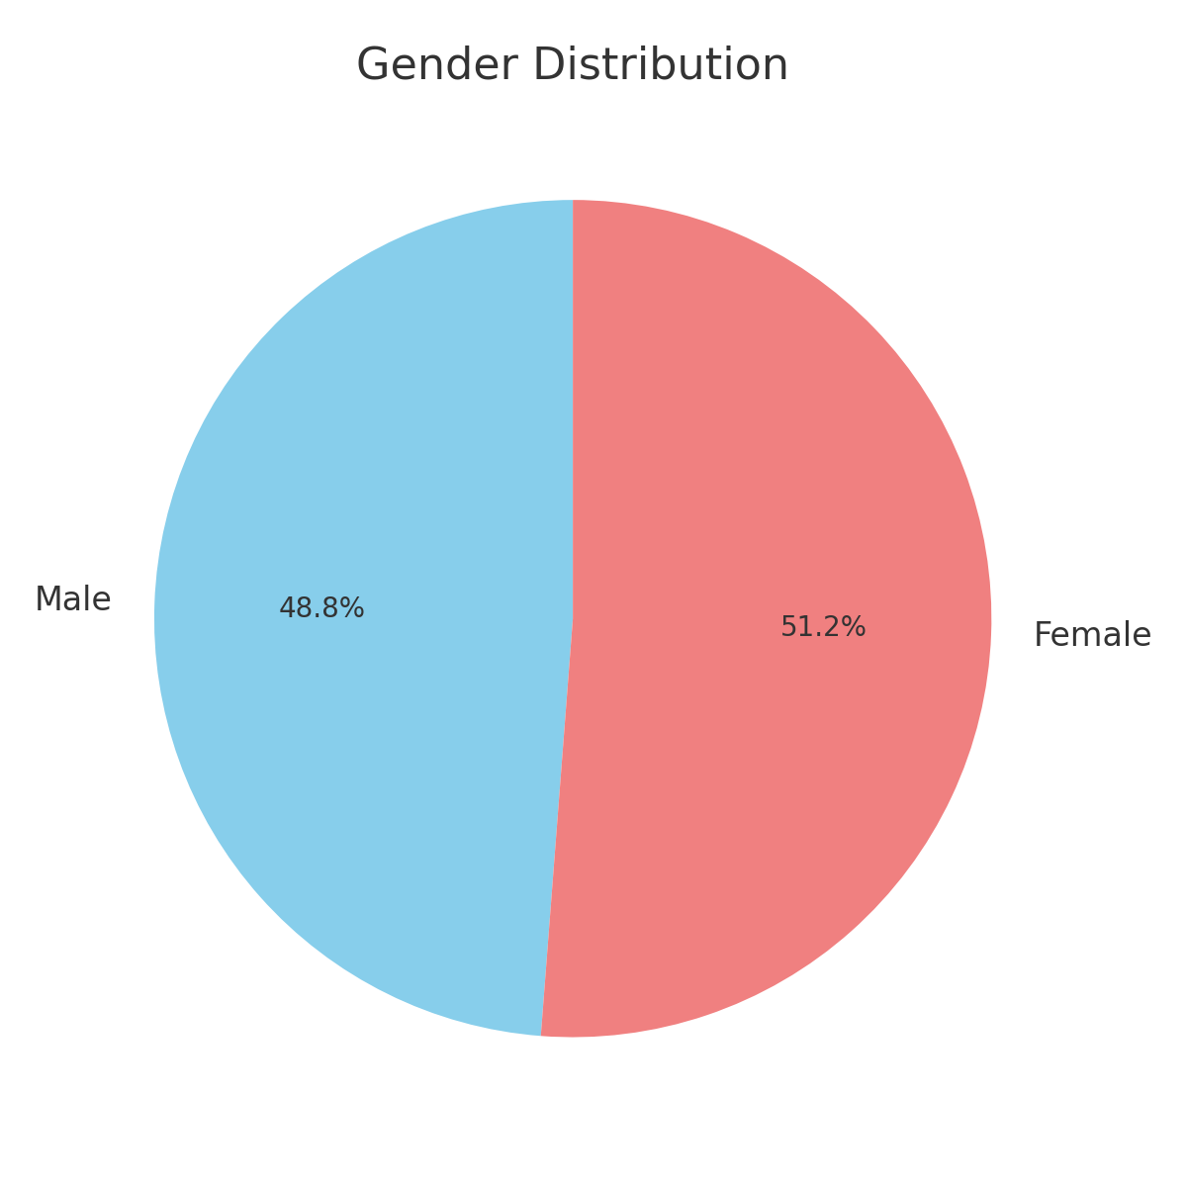
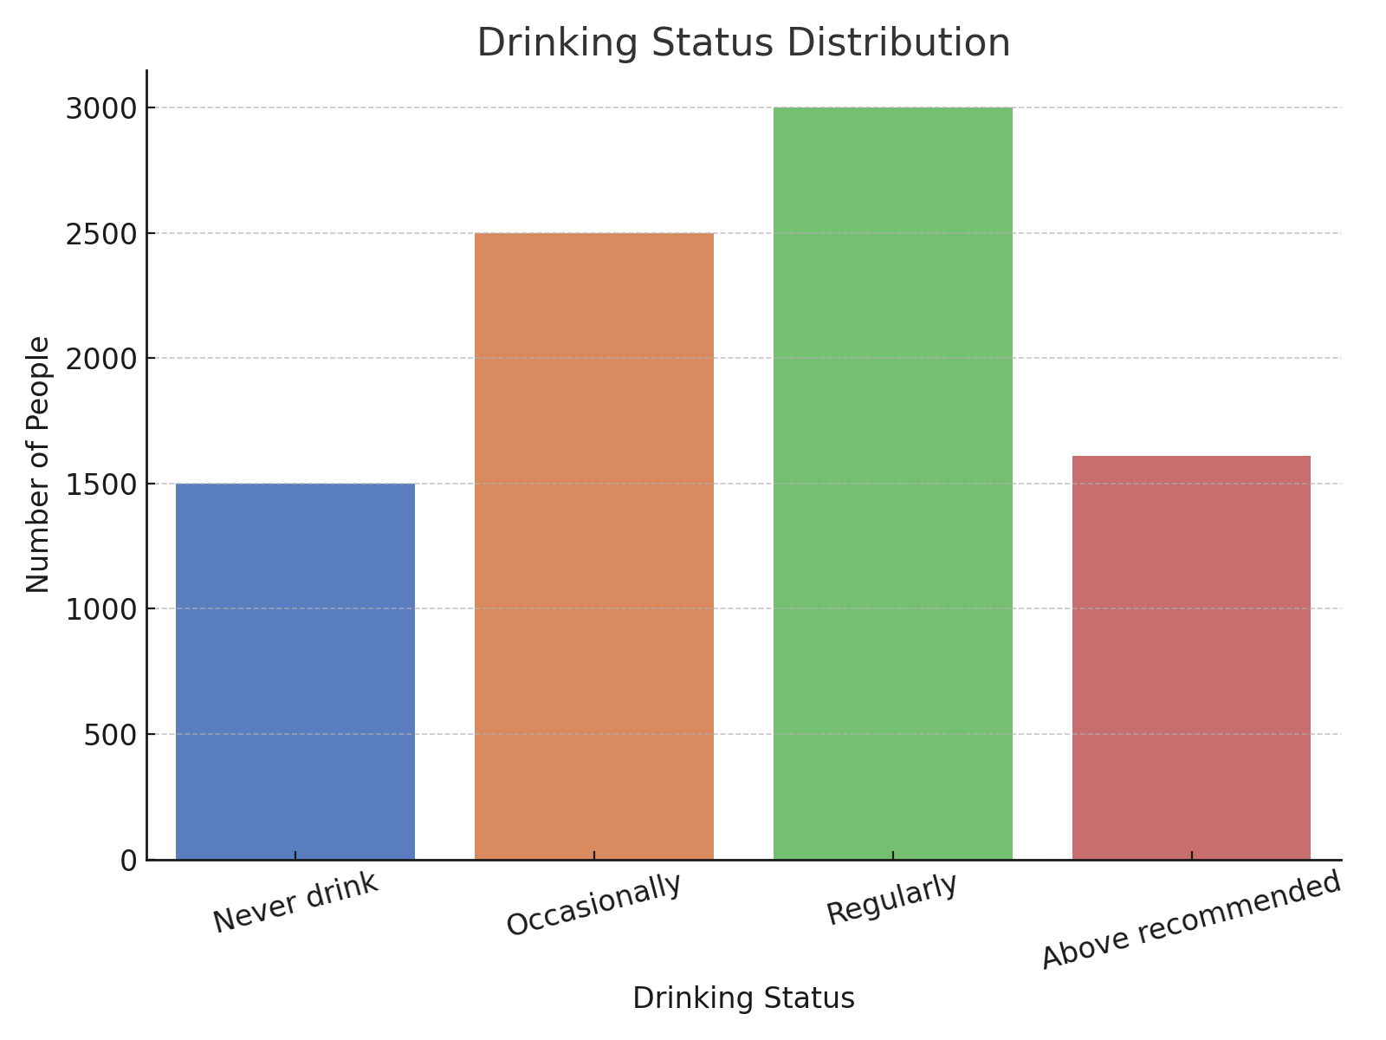
Sample Overview

Slide 8
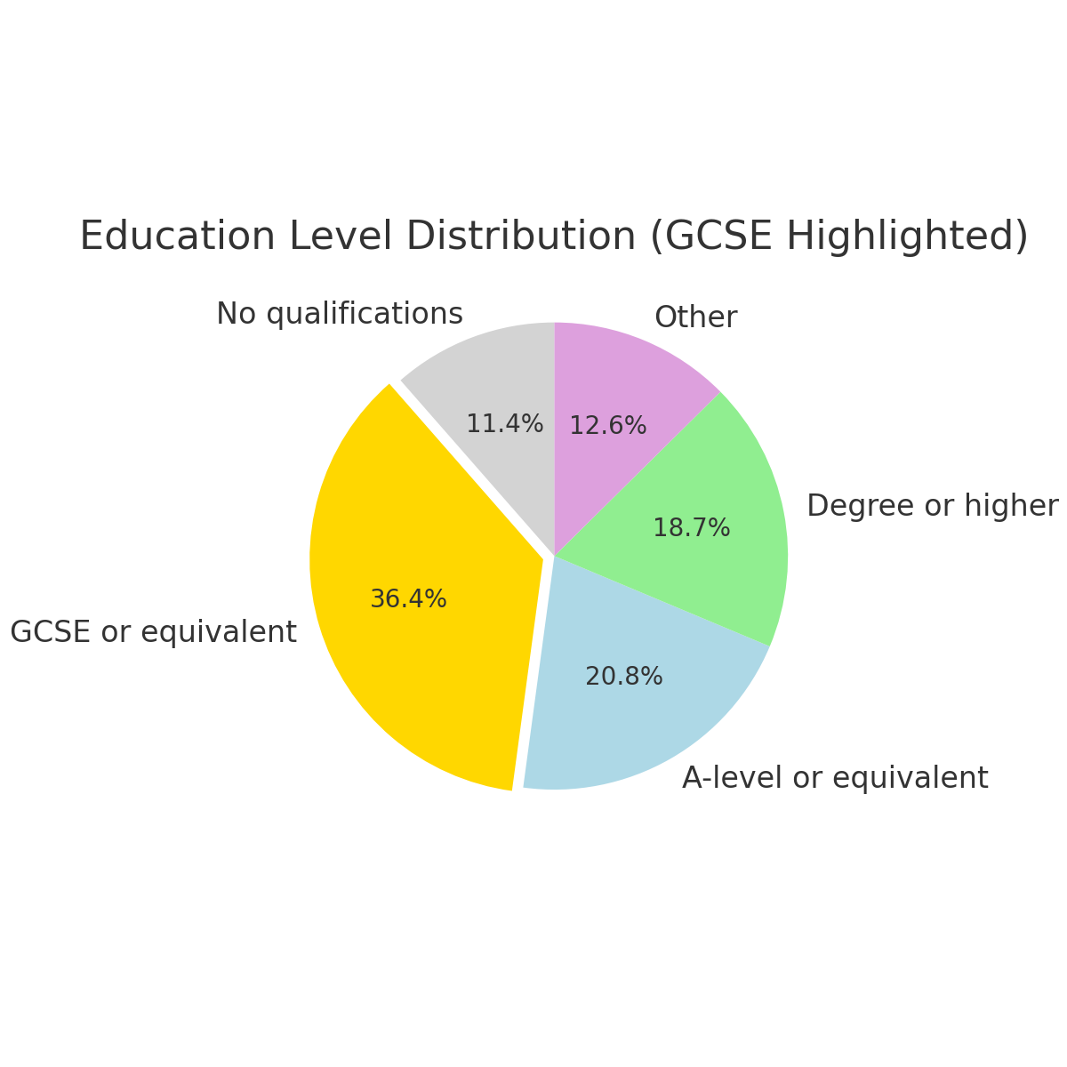
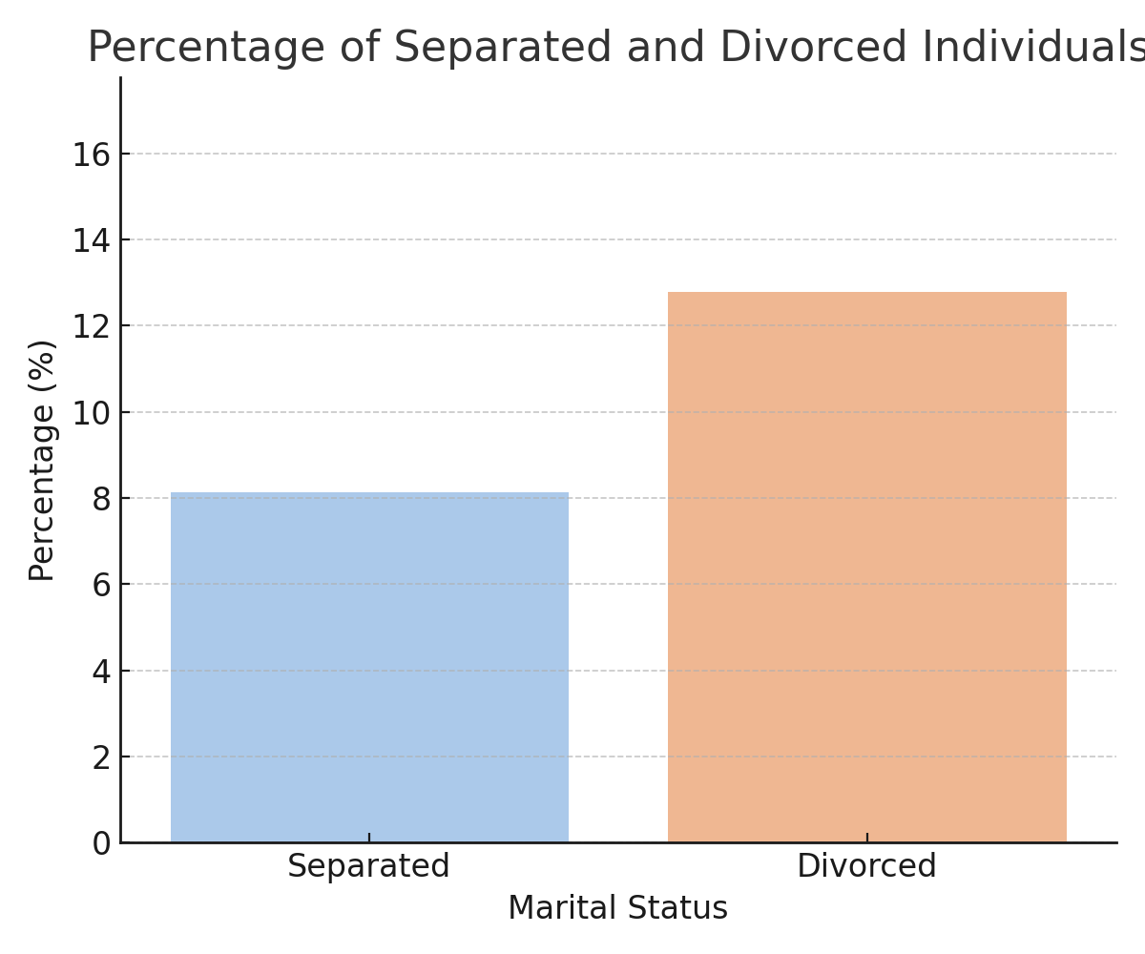
Demographics

Slide 9
Summary Statistics for Key Variables
Variable | Mean | Median | Mode | Min | Max | Range | SD
Household Size | 2.6 | 2 | 2 | 1 | 8 | 7 | 1.2
BMI | 27.1 | 26.5 | 24 | 16 | 55 | 39 | 5.4
Age | 49.3 | 48 | 55 | 16 | 99 | 83 | 17.1

Slide 10
Inferential Statistics
03

Slide 11
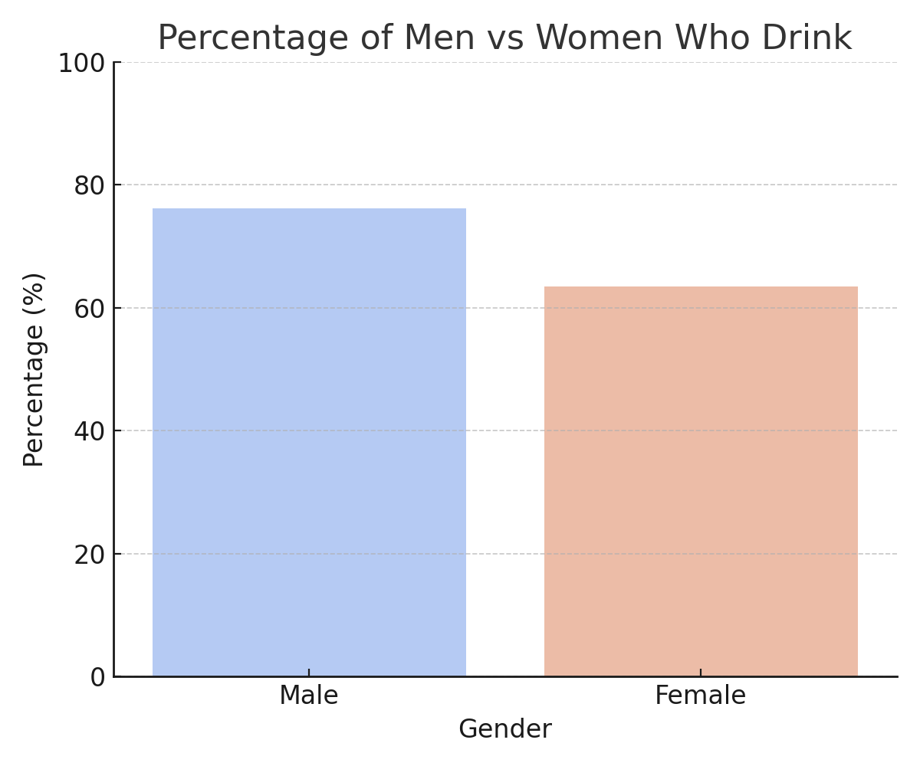
Gender vs Alcohol Use
63.5%
Female
76.2%
Male
Chi-squared test results (p < 0.001)

Slide 12
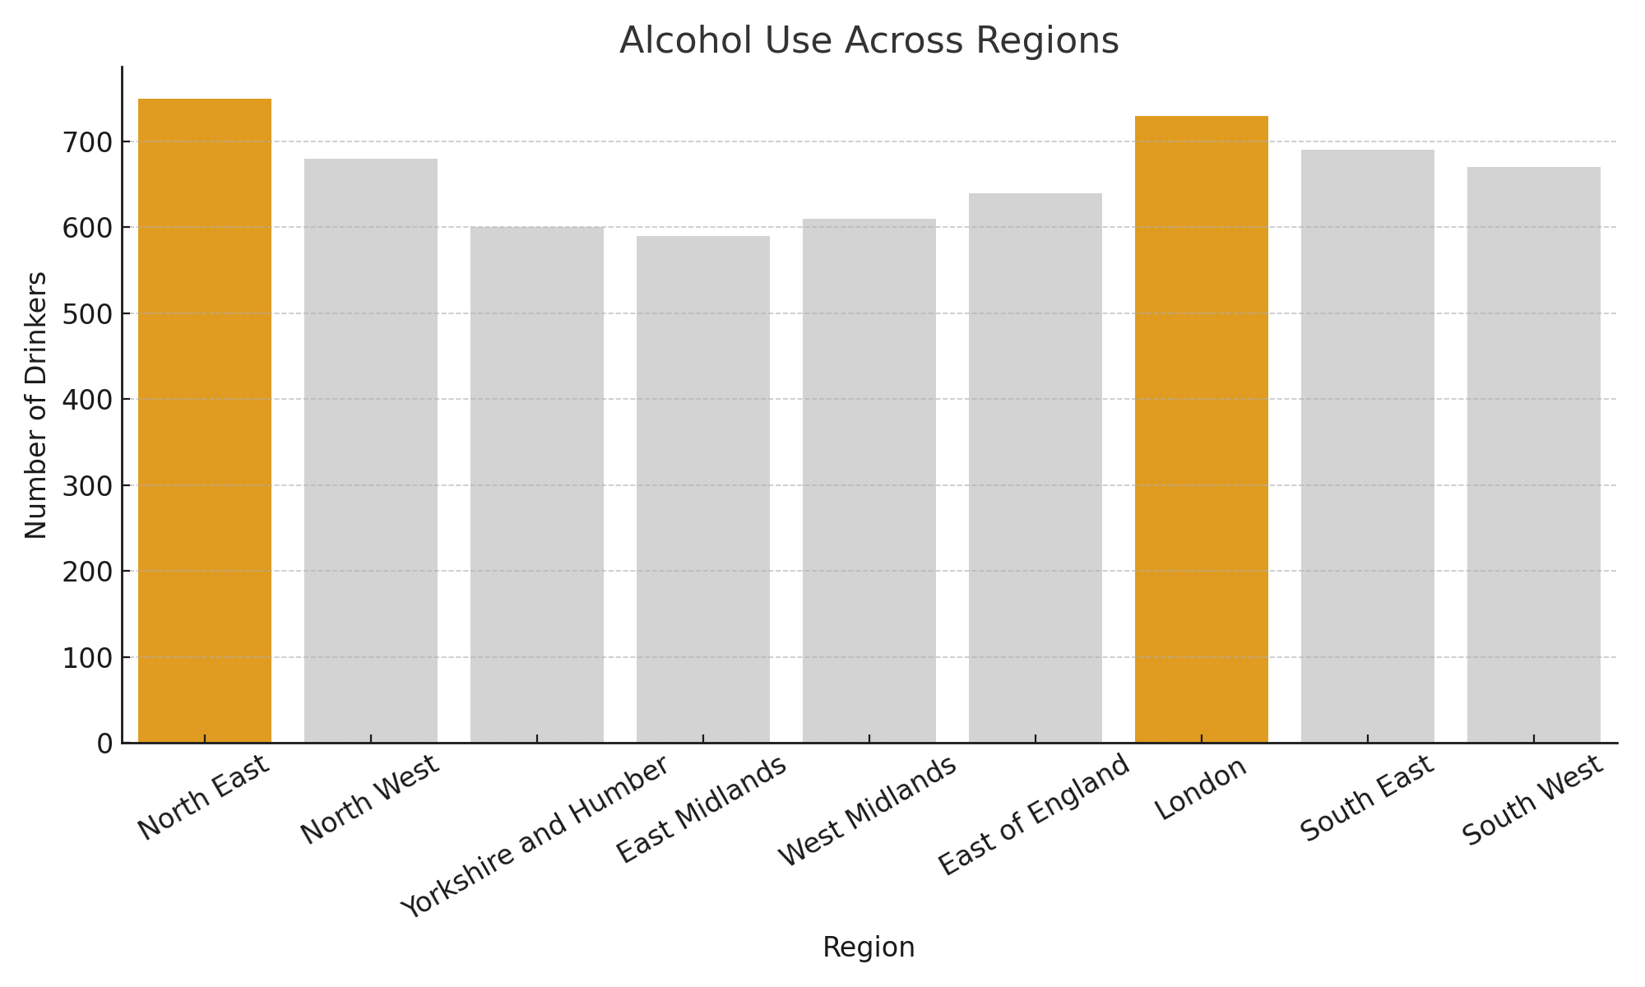
Region and Alcohol Use
ANOVA p-value is: p < 0.001

Slide 13
Height and Weight by Gender
Mean Height (cm)
Mean Weight (kg)

Slide 14
Correlation Analysis
 | Drinking Status | Household Income | Age | Gender
Drinking Status | 1.00 | 0.21 | -0.10 | -0.15
Household Income | 0.21 | 1.00 | -0.08 | 0.05
Age | -0.10 | -0.08 | 1.00 | 0.03
Gender | -0.15 | 0.05 | 0.03 | 1.00

Slide 15
Discussion of your findings
04

Slide 16
Discussion
Key themes:
Gender gap
Regional inequality
Role of income and age
Literature: Lewer et al. (2020), Wilsnack et al. (2000), Rehm et al.(2009)

Slide 17
Conclusion
05

Slide 18
Conclusions
Key findings summarized
Men and younger people drink more
Income and region influence drinking patterns
Gender differences in height/weight are confirmed

Slide 19
Recommendations
01
02
03
Gender-specific campaigns
Regional policies
Continued monitoring throught surveys

Slide 20
Appendix
06

Slide 21
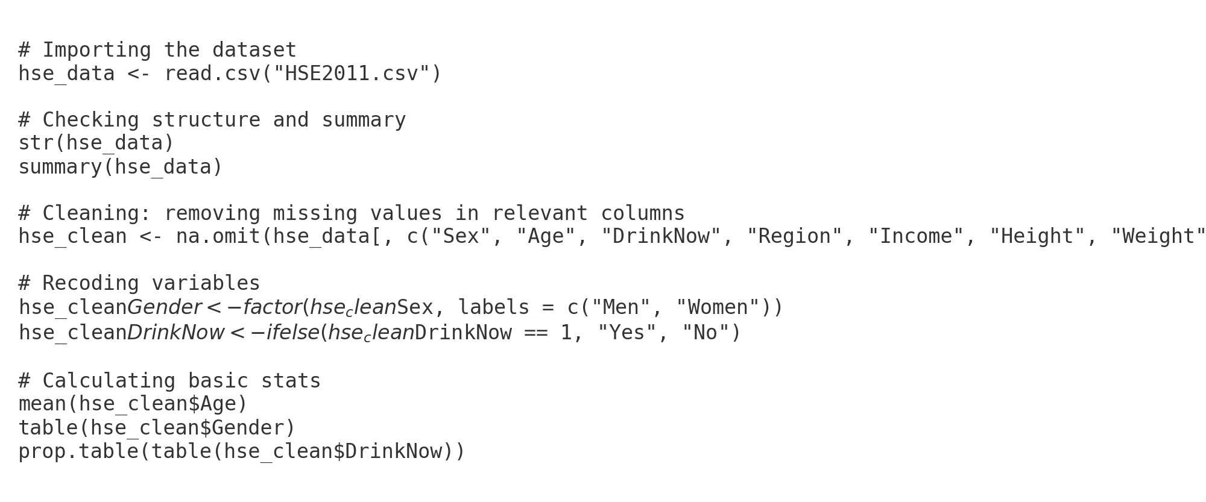
Appendix (R Command)
Reference to full script in Word report

Slide 22
References
Office for National Statistics (2019)
Rehm et al. (2009)
Wilsnack et al. (2000)
Lewer et al. (2020)

Slide 23
Thanks!
Do you have any questions?

